Slide 1
Project background

Slide 2
Multi-omics of Celiac in Down syndrome
Individuals with Trisomy 21 are significantly more likely to develop Celiac disease.
I partnered with Dr. Marisa Stahl, pediatric gastroenterologist, to develop a K grant proposal to investigate the role of genetics and other omics in the etiology of Celiac disease in Down syndrome.
K grant proposal was successful!
Once funded, we began by characterizing the role of genetics in the etiology of Celiac in Down syndrome as compared to in the typical population.

Slide 3
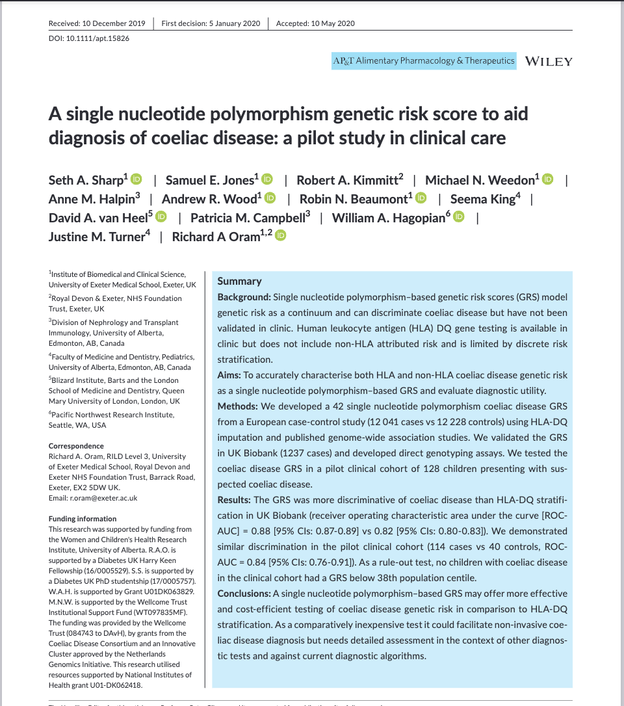
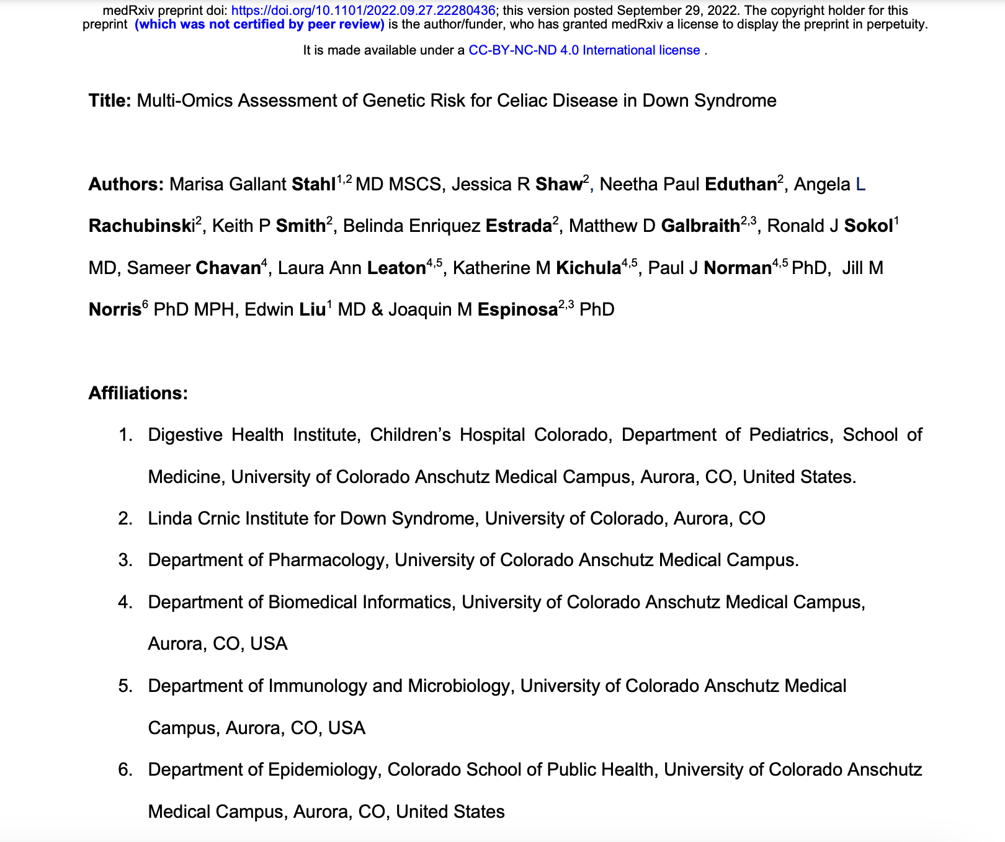
Multi-omics of Celiac in Down syndrome
Celiac disease is known to be highly influenced by genetics.
Genetic predisposition to Celiac disease is typically assessed by genotyping of the HLA-DQ region of the genome.
Sharp et al., 2019 developed a genetic risk score for celiac disease that accurately predicts CD using a combination of both HLA-DQ genotypes and non-HLA-DQ SNPs.
We applied this GRS to a cohort of individuals with Trisomy 21 +/- Celiac disease, evaluated associations of individual components of the GRS, and assessed ways to improve the performance of this GRS in the Down syndrome population.

Slide 4
Primer on HLA genetics of Celiac disease

Slide 5
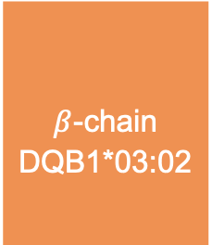
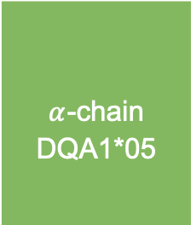
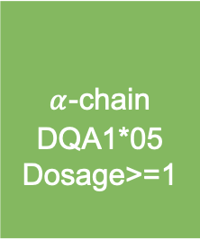
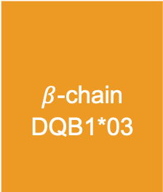
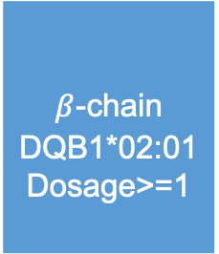
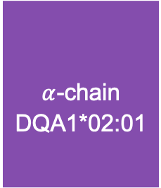
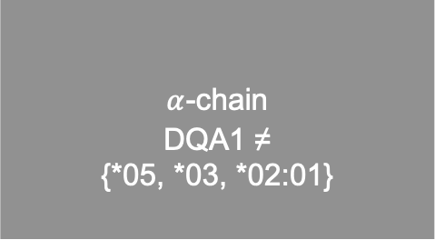
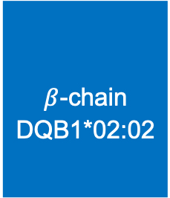
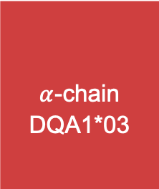
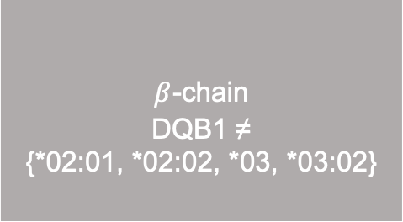
Pairs of HLA-DQ alleles form HLA-DQ heterodimers
$α$_{-chain}
_{DQA1*05}
_{Dosage>=1}
_{DQ2.5}
$β$_{-chain}
_{DQB1*02:01}
_{Dosage>=1}
$α$_{-chain}
_{DQA1*02:01}
_{DQ2.2}
$β$_{-chain}
_{DQB1*02:02}
Alleles encoding CD-associated heterodimers
$α$_{-chain}
_{DQA1*03}
_{DQ8}
$β$_{-chain}
_{DQB1*03:02}
$α$_{-chain}
_{DQA1*05}
_{DQ7.5}
$β$_{-chain}
_{DQB1*03}
Subset of many possible HLA alleles at DQA1 and DQB1
DQ2.5 <- ifelse(Dosage_DQA105 >=1 & Dosage_DQB10201>=1, 1, 0)
DQ2.2 <- ifelse(Dosage_DQA10201 >=1 & Dosage_DQB10202>=1, 1, 0)
$α$_{-chain}
_{DQA1 ≠}
_{{*05, *03, *02:01}}
_{DQX}
$β$_{-chain}
_{DQB1 ≠}
_{{*02:01, *02:02, *03, *03:02}}
Figure adapted from:
Megiorni, Francesca, and Antonio Pizzuti. “HLA-DQA1 and HLA-DQB1 in Celiac Disease Predisposition: Practical Implications of the HLA Molecular Typing.” Journal of Biomedical Science, vol. 19, no. 1, 2012, p. 88. DOI.org (Crossref), https://doi.org/10.1186/1423-0127-19-88.
Notes:
_{Ifelse(Dosage_DQA105 >=1}

Slide 6
Pairs of HLA-DQ alleles form HLA-DQ heterodimers
$α$_{-chain}
_{DQA1*05}
_{Dosage>=1}
_{DQ2.5}
$β$_{-chain}
_{DQB1*02:01}
_{Dosage>=1}
$α$_{-chain}
_{DQA1*02:01}
_{DQ2.2}
$β$_{-chain}
_{DQB1*02:02}
DQ2.5 <- ifelse(Dosage_DQA105 >=1 & Dosage_DQB10201>=1, 1, 0)
DQ2.2 <- ifelse(Dosage_DQA10201 >=1 & Dosage_DQB10202>=1, 1, 0)
Genotype = ifelse(DQ2.5 == 1 & DQ2.2 == 1, “DQ2.5/DQ2.2,
_{Ifelse(….}
_{Ifelse(}
$α$_{-chain}
_{DQA1*03}
_{DQ8}
$β$_{-chain}
_{DQB1*03:02}
$α$_{-chain}
_{DQA1*05}
_{DQ7.5}
$β$_{-chain}
_{DQB1*03}
$α$_{-chain}
_{DQA1 ≠}
_{{*05, *03, *02:01}}
_{DQX}
$β$_{-chain}
_{DQB1 ≠}
_{{*02:01, *02:02, *03, *03:02}}
Figure adapted from:
Megiorni, Francesca, and Antonio Pizzuti. “HLA-DQA1 and HLA-DQB1 in Celiac Disease Predisposition: Practical Implications of the HLA Molecular Typing.” Journal of Biomedical Science, vol. 19, no. 1, 2012, p. 88. DOI.org (Crossref), https://doi.org/10.1186/1423-0127-19-88.
Notes:
_{Ifelse(Dosage_DQA105 >=1}

Slide 7
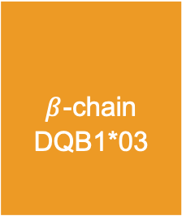
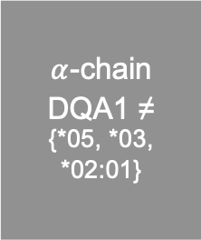
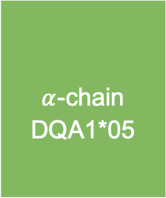
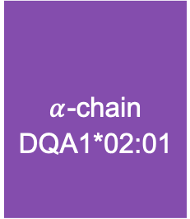
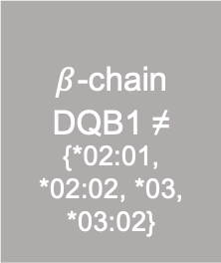
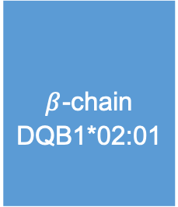
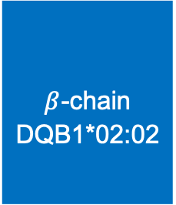

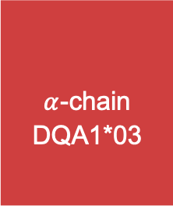
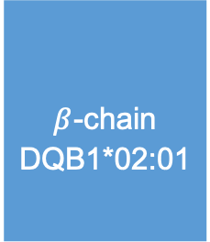
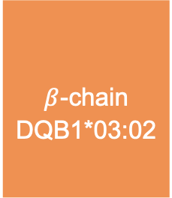
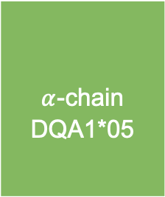
Pairs of HLA-DQ heterodimers form HLA-DQ genotypes
For example:
_{Chromosome 6, paternal}
_{Chromosome 6, maternal}
$α$_{-chain}
_{DQA1*05}
_{DQ2.5}
$β$_{-chain}
_{DQB1*02:01}
$α$_{-chain}
_{DQA1*02:01}
_{DQ2.2}
$β$_{-chain}
_{DQB1*02:02}
HLA-DQ genotype
DQ2.5/DQ2.5
DQ2.5/DQ2.2
DQ7.5/DQ2.2
DQ2.5/DQ8
DQ2.5/X
DQ7.5/DQ2.5
DQ8/DQ8
DQ2.2/DQ8
DQ2.2/DQ2.2
DQ7.5/DQ8
DQ8/X
DQ2.2/X
DQ7.5/X
DQ7.5/DQ7.5
X/X
_{DQ2.5}
$α$_{-chain}
_{DQA1*03}
_{DQ8}
$β$_{-chain}
_{DQB1*03:02}
$α$_{-chain}
_{DQA1*05}
$β$_{-chain}
_{DQB1*02:01}
$α$_{-chain}
_{DQA1*05}
_{DQ7.5}
$β$_{-chain}
_{DQB1*03}
_{DQX}
$α$_{-chain}
_{DQA1 ≠}
_{{*05, *03, *02:01}}
$β$_{-chain}
_{DQB1 ≠}
_{{*02:01, *02:02, *03, *03:02}}

Slide 8
Analysis overview

Slide 9
GRS analysis overview
Key outputs
ROC curve
AUC for comparison to Sharp et al., 2019.
Logistic regression:
GRS
Celiac (0/1) ~
Logistic regression:
HLA-DQ genotype dosage (0/1)
+
PC1
+ … +
PC5
Celiac (0/1) ~
OR barplots
Frequency stacked barplots
Volcano plot
Comparison to Sharp et al., 2019
Logistic regression:
GRS risk allele dosage (0/1/2)
+
PC1
+ … +
PC5
Celiac (0/1) ~
OR barplots
Volcano plot
Comparison to Sharp et al., 2019
OR barplots
Volcano plot
Comparison to Sharp et al., 2019
Logistic regression:
HLA-DQ allele group dosage (0/1/2)
+
PC1
+ … +
PC5
Celiac (0/1) ~

Slide 10
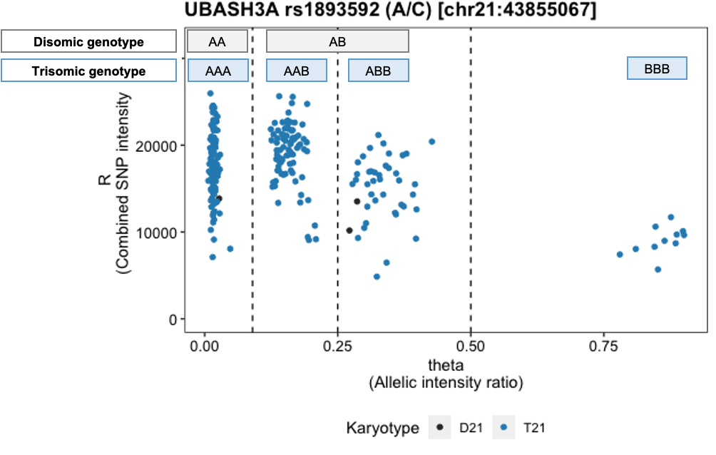
Analysis data pipeline GRS component: Non-HLA-DQ SNPs
Non-HLA-DQ, non-chromosome 21 SNPs captured by Illumina MEGA
Extract non-HLA-DQ, non-chr21 GRS SNPs
R/bash/UCSC Genome Browser/Plink
Infer strand and derive GRS allele dosages
R
Illumina MEGA
genome-wide
SNP data (*.bed/*.bim/*.fam)
Non-HLA-DQ, non-chr21 GRS SNP dosages
(0/1/2)
Non-HLA-DQ, non-chr21 GRS SNP genotypes
Chromosome 21 SNP captured by Illumina MEGA
Extract chr21 SNP (rs1893592)
R/illuminaio/
bash
Manual genotype clustering
R
Genome-wide allelic intensity data (*.idat)
chr21 SNP intensity data
(*.idat)
chr21 SNP dosages
(0/1/2/3)

Slide 11
Analysis data pipeline GRS component: Non-HLA-DQ SNPs (continued)
Non-HLA-DQ, non-chromosome 21 SNPs not captured by Illumina MEGA
Imputation prep
R/Plink/bcftools/bash/
W. Rayner strand alignment
Genome imputation
Michigan Imputation Server (MIS)
Panel: 1000GP3v5
Population: Other/Mixed
Illumina Multi Ethnic Global Array (MEGA)
genome-wide
SNP data
(*.bed/*.bim/*.fam)
Imputation-ready genome-wide SNP data
Extract non-chr21,
non-HLA-DQ GRS SNPs
R/Plink/bash/bcftools
QC imputation results
R/Plink/bash/
bcftools
Genome-wide imputed genotypes
(*.vcf.gz, *.vcf.gz.csi)
Non-HLA-DQ, non-chr21 SNP dosages
(0/1/2)
…
Analysis-eligible non-HLA-DQ, non-chr21 SNP genotypes
Infer strand and derive GRS allele dosage
R
…
Non-HLA-DQ, non-chr21 GRS allele dosages
(0/1/2)

Slide 12
Analysis data pipeline GRS component: HLA-DQ genotypes
HLA-DQ genotypes not captured by Illumina MEGA
HLA imputation (HIBAG*)
R
HLA-DQ
CD-associated allele dosages
R
R
HLA-DQ genotype dosages
(0/1)
Illumina MEGA
genome-wide
SNP data (*.bed/*.bim/*.fam)
HLA-DQ
2-5 digit alleles
HLA-DQ
heterodimer dosages
*Performed by Paul Norman et al.

Slide 13
Analysis data pipeline Celiac GRS calculation
Weight for each HLA-DQ genotype given in Sharp et al., 2019, Table S2
Weights for each non-HLA-DQ SNP genotype given in Sharp et al., 2019 Table S3
Score allele dosage extracted from MEGA genotype data (dosage 0/1/2), extracted from genome-wide imputation results (dosage 0/1/2), or derived after manual genotype clustering to account for trisomy 21 (dosage 0/1/2/3)
4.97
DQ2.5/DQ2.5
dosage
(0/1)
4.96
DQ2.5/DQ2.2
dosage
(0/1)
…
0.0
X/X
dosage
(0/1)
GRS =
x
+
x
+
+
x
+
0.425
rs4143332 (C) dosage
(0/1/2)
0.372
x
rs3128927 (T) dosage (0/1/2)
x
+
+ … +
-0.128
x
rs1893592 (C) dosage (0/1/2/3)
+ … +
-0.083
rs10167650 (G) dosage
(0/1/2)
x

Slide 14
Analysis data pipeline Additional data for variant-level analyses
Illumina MEGA
genome-wide
SNP data (*.bed/*.bim/*.fam)
HLA imputation (HIBAG*)
R
HLA-DQ
CD-associated allele dosages
R
R
HLA-DQ genotype dosages
(0/1)
HLA-DQ
2-5 digit alleles
HLA-DQ
heterodimer dosages
HLA allele imputation (HIBAG*)
R
MEGA genome-wide
SNP data (*.bed/*.bim/*.fam)
HLA-DQ
alleles
HLA-DQ
allele group dosage (0/1/2)
Plink data preparation
Plink PCA
MEGA genome-wide
SNP data
SNPs for PCA
PCs for genetic ancestry
Filter samples according to inclusion/exclusion criteria
Exclude variants according to inclusion/exclusion criteria
Apply threshold-based variant filters
*Performed by Paul Norman et al.

Slide 15
Selected results/figures

Slide 16
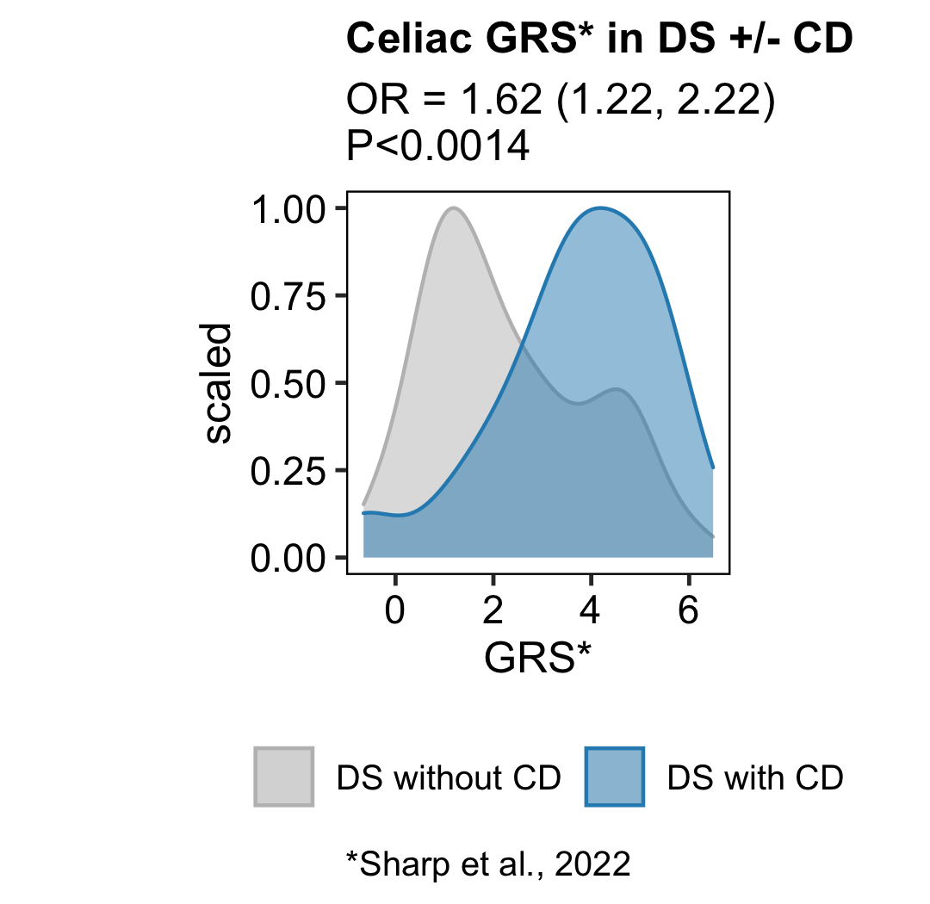
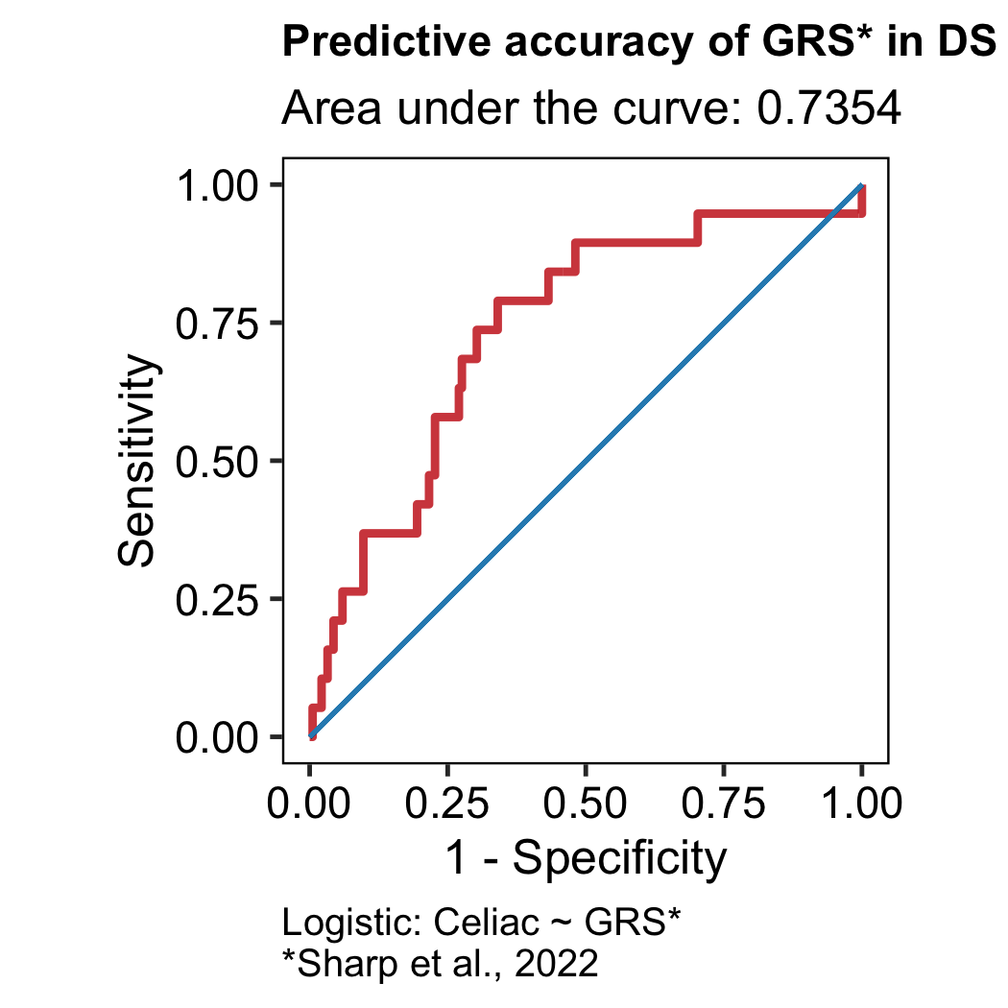
GRS performance in DS
(GRS version: Sharp et al., 2022)

Slide 17
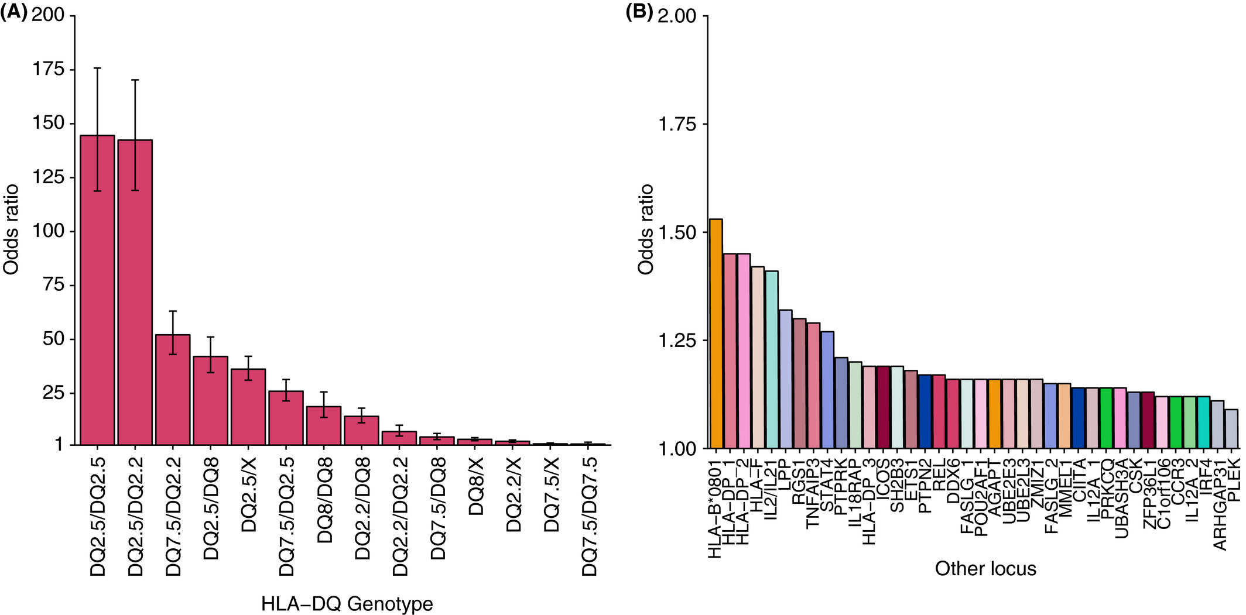
Figure 1 of Sharp et al., 2019
A single nucleotide polymorphism genetic risk score to aid diagnosis of coeliac disease: a pilot study in clinical care
Aliment Pharmacol Ther, Volume: 52, Issue: 7, Pages: 1165-1173, First published: 13 August 2020, DOI: (10.1111/apt.15826)
Notes:
Odds ratios for coeliac disease GRS components grouped by (A) HLA‐DQ genotype and (B) putative genes at loci outside of HLA‐DQ that were associated with coeliac disease from recent genome‐wide association studies
IF THIS IMAGE HAS BEEN PROVIDED BY OR IS OWNED BY A THIRD PARTY, AS INDICATED IN THE CAPTION LINE, THEN FURTHER PERMISSION MAY BE NEEDED BEFORE ANY FURTHER USE. PLEASE CONTACT WILEY'S PERMISSIONS DEPARTMENT ON PERMISSIONS@WILEY.COM OR USE THE RIGHTSLINK SERVICE BY CLICKING ON THE 'REQUEST PERMISSIONS' LINK ACCOMPANYING THIS ARTICLE. WILEY OR AUTHOR OWNED IMAGES MAY BE USED FOR NON-COMMERCIAL PURPOSES, SUBJECT TO PROPER CITATION OF THE ARTICLE, AUTHOR, AND PUBLISHER.

Slide 18
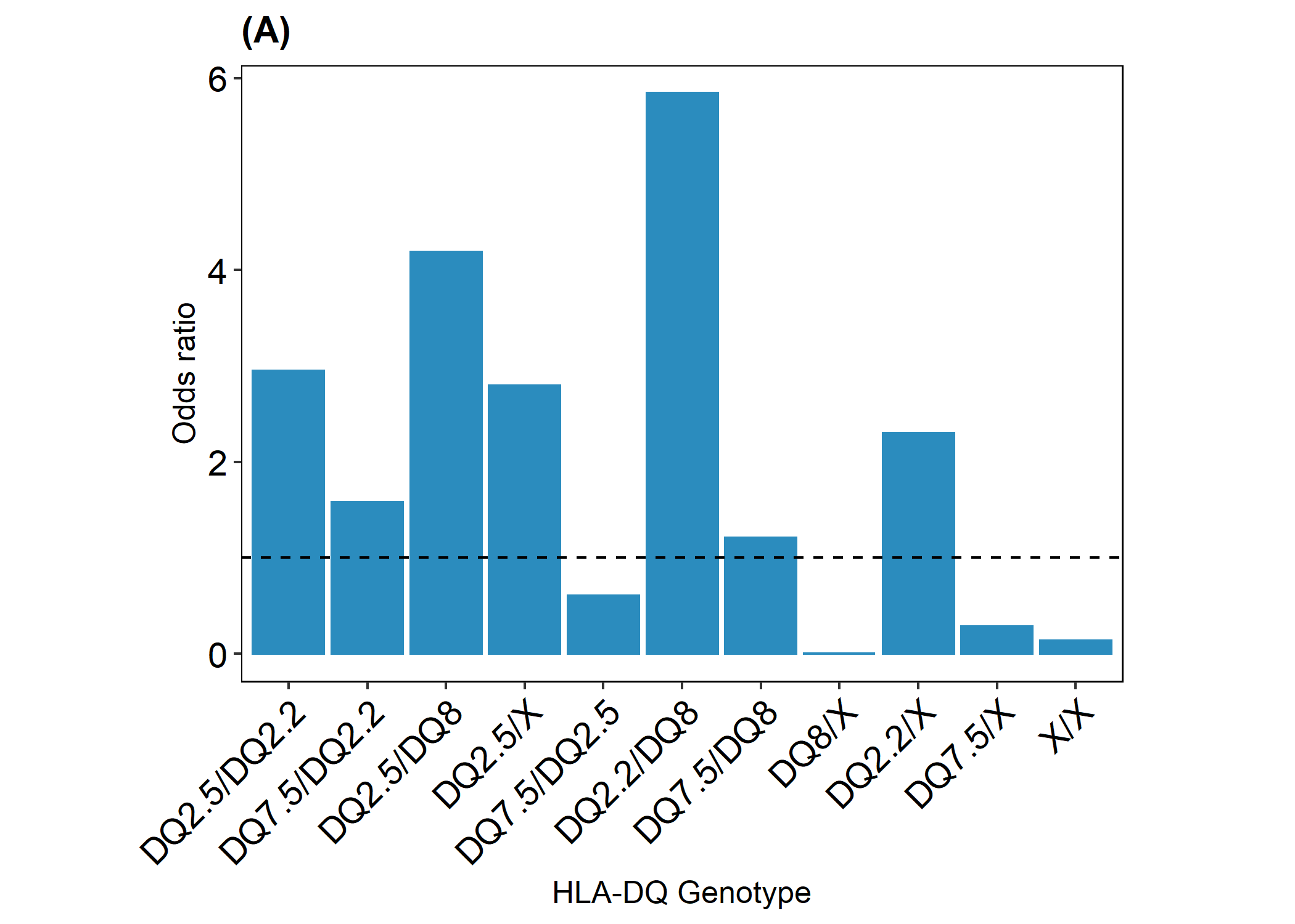
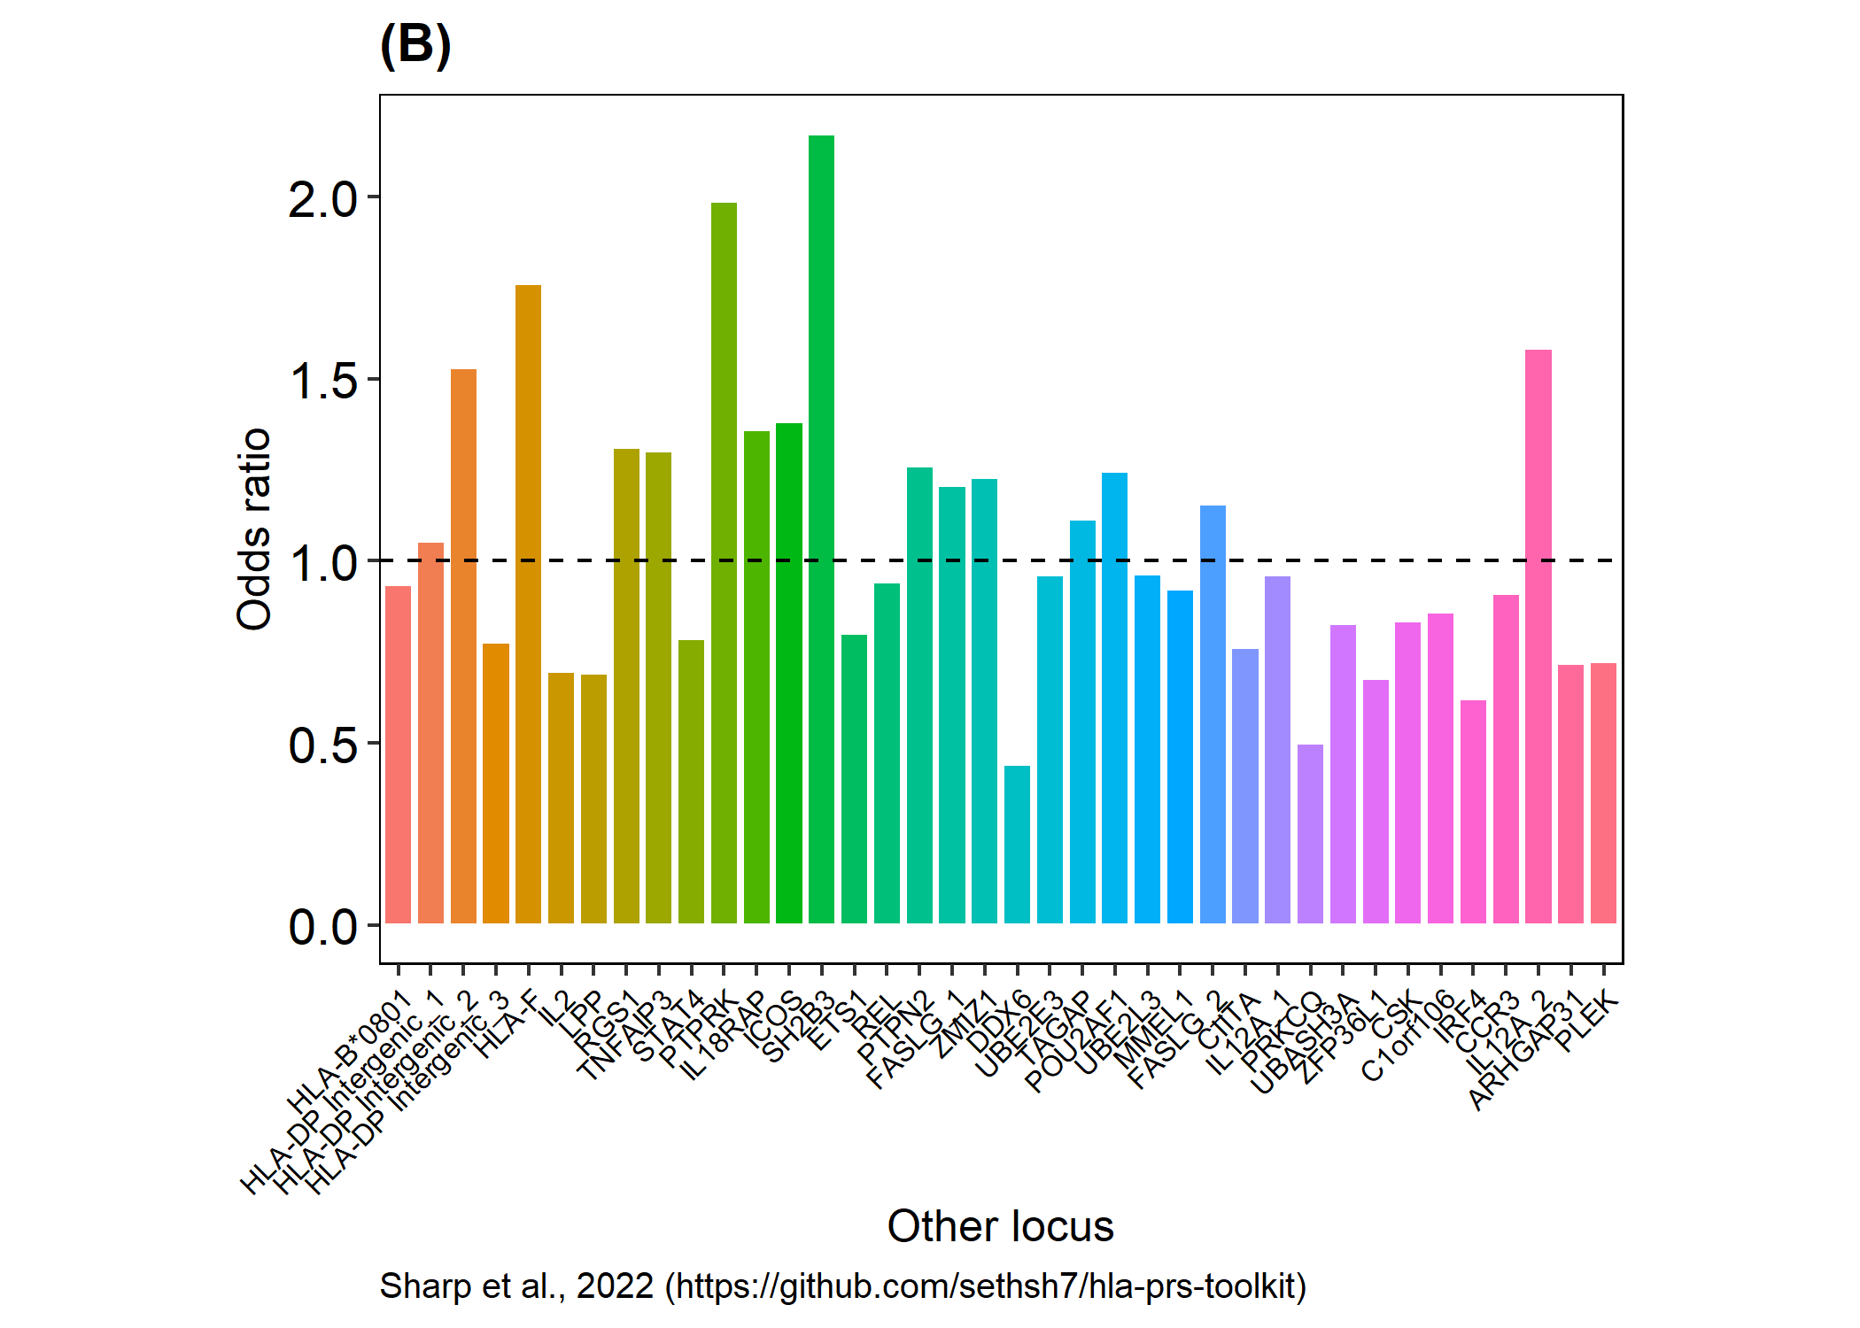
Odds ratios observed in the HTP Revised GRS (Sharp et al., 2022)

Slide 19
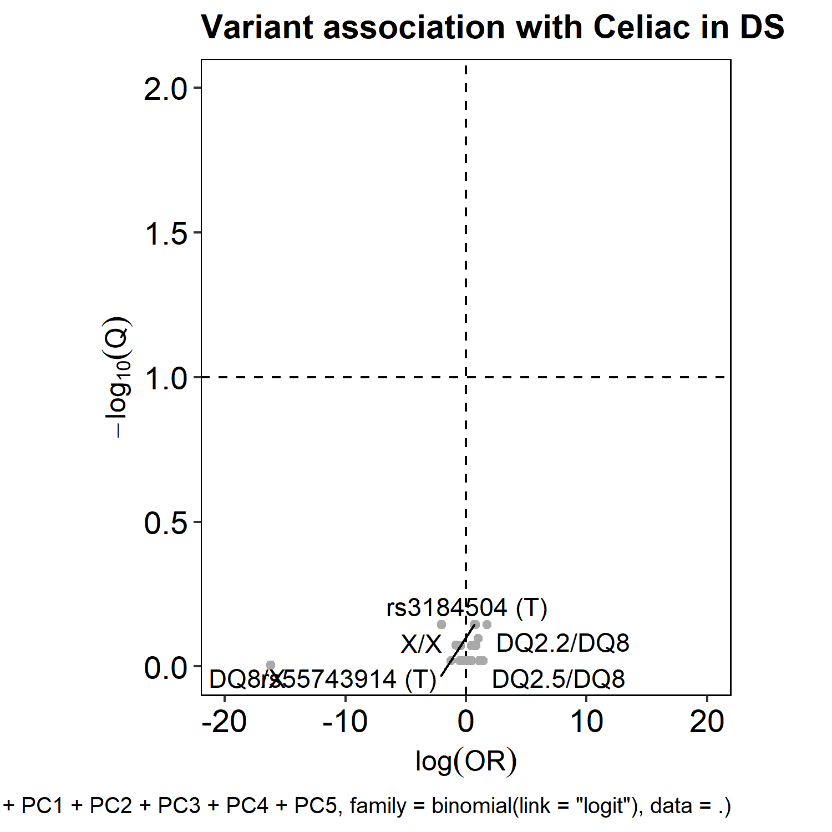
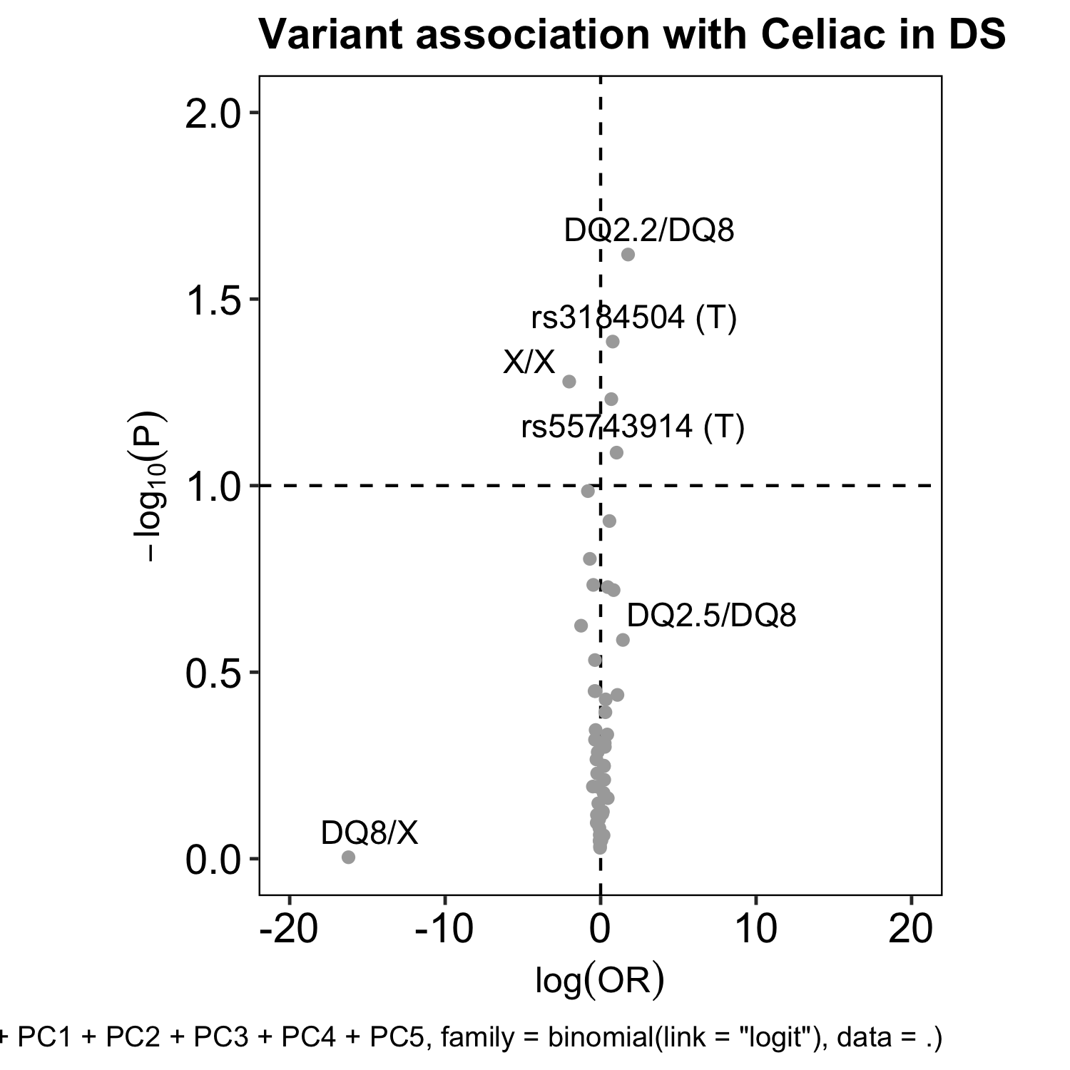
Results of single-variant logistic regression models for CD (0/1) versus dosage of score allele
(GRS version: Sharp et al., 2022)

Slide 20
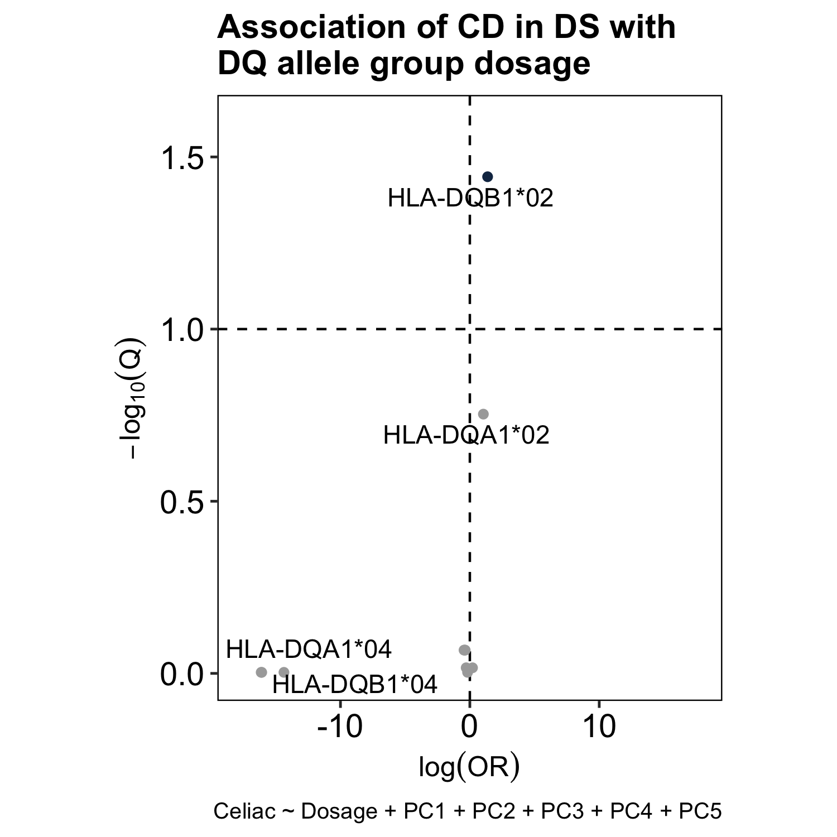
Dosage of DQB1*02 alleles is significantly associated with CD in DS
Alleles encoding CD-associated heterodimers
HLA-DQB1*02
In an additive genetic model, dosage of DQB1*02 alleles (e.g., DQB1*02:01, DQB1*02:02) was significantly associated with Celiac disease in Down syndrome (OR = 3.95, Q<0.0361).
On average, each additional DQB1*02 allele corresponded to a 3.95-fold increase in the odds of CD in DS.

Slide 21
Possible dominant association of DQB1*02 with a 7.81-fold increase in the odds of CD in DS
To identify non-additive associations (i.e., dominant, recessive), we performed a follow-up analysis of DQ allele group dosage as a categorical predictor, rather than numeric.
Carrying one DQB1*02 allele was associated with a 7.81-fold increase in the odds of CD in DS (OR = 7.81, Q< 0.0534), as compared to carrying zero DQB1*02 alleles.
By contrast, we found no significant difference in the odds of Celiac given two DQB1*02 alleles compared to one (OR = 0.80, Q<0.9999).
These results may indicate a dominant effect of DQB1*02 in the pathogenesis of CD in individuals with DS (OR = 7.81, Q<0.0534).

Slide 22
Dominant association of DQB1*02 with a 7.81-fold increase in the odds of Celiac disease in Down syndrome
84.2% of Celiac cases (16/19) carried one or more DQB1*02 allele, with the DQ genotypes:
DQ2.5/X (n=5)
DQ2.2/X (n=4)
DQ2.2/DQ8 (n=3)
DQ2.5/DQ2.2 (n=1)
DQ2.5/DQ8 (n=1)
DQ7.5/DQ2.2 (n=1)
DQ7.5/DQ2.5 (n=1)
Only three Celiac cases were not carriers of DQB1*02, instead presenting with the genotypes:
DQ7.5/DQ8 (n=1)
DQ7.5/X (n=1)
X/X (n=1)
Alleles encoding traditionally CD-associated heterodimers

Slide 23
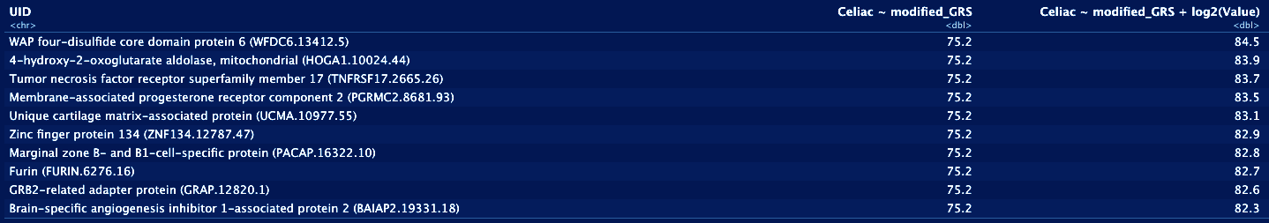
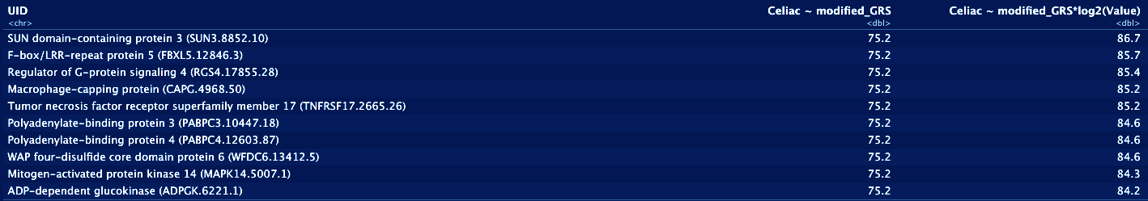
Models involving both GRS and single protein abundance improve prediction of celiac disease in Down syndrome (Please email Jessica.rose.shaw@gmail.com for details)
Prediction of celiac status using GRS* and abundance of any one protein as precision covariate
AUC values
Prediction of celiac status with interaction of GRS* and abundance of any one protein
AUC values

Slide 24
Questions?

